Slide 1
Team 6 Swivel
Schietecat M.
Smets K.

Slide 2
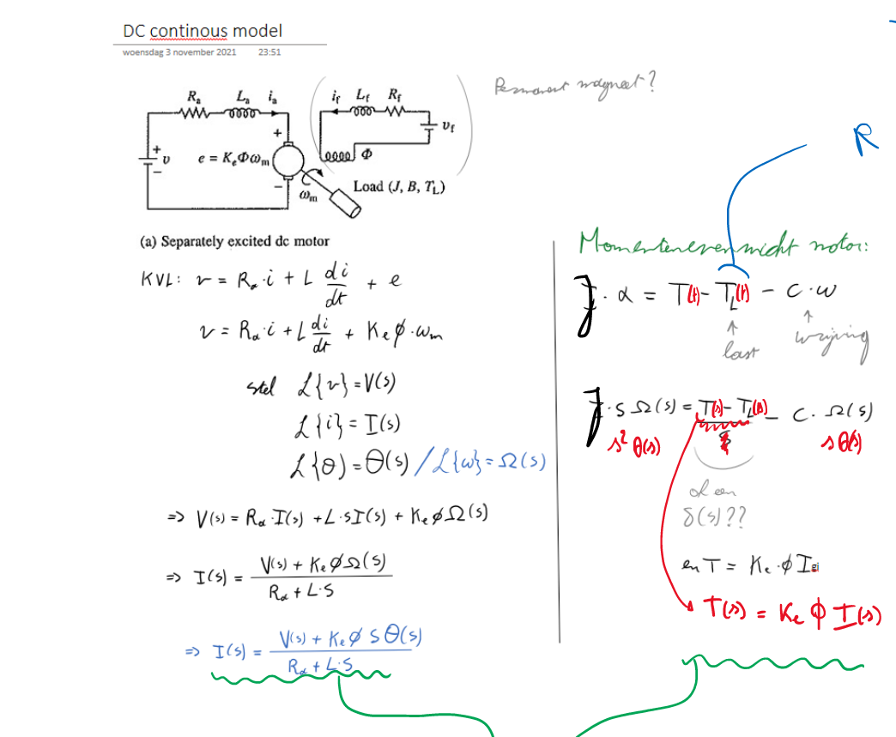

Model
Resulting TF
Discrete form:
5 zero’s
6 poles (incl 1 delay)

Slide 3
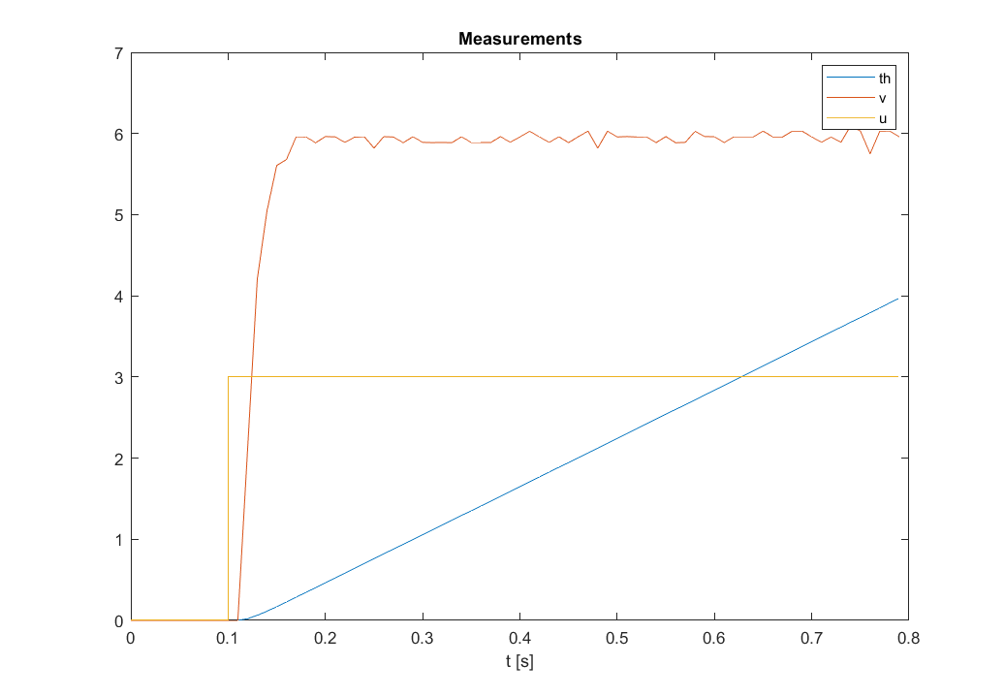
Excitation

Slide 4
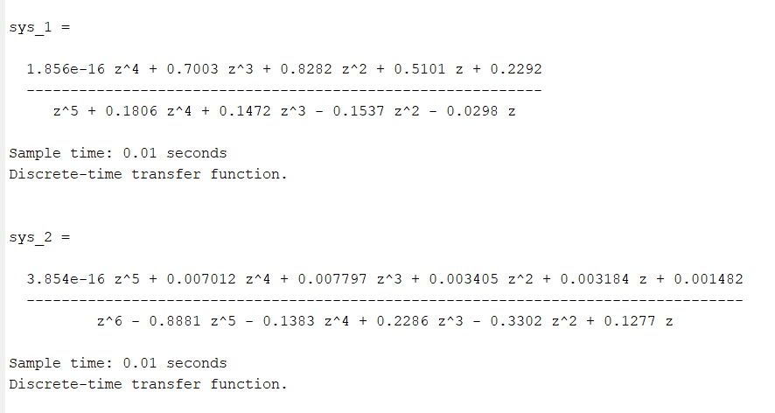
Results

Slide 5
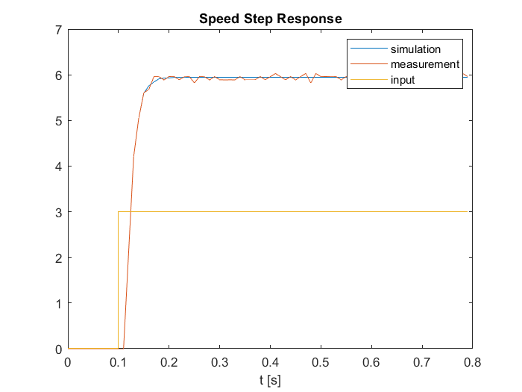
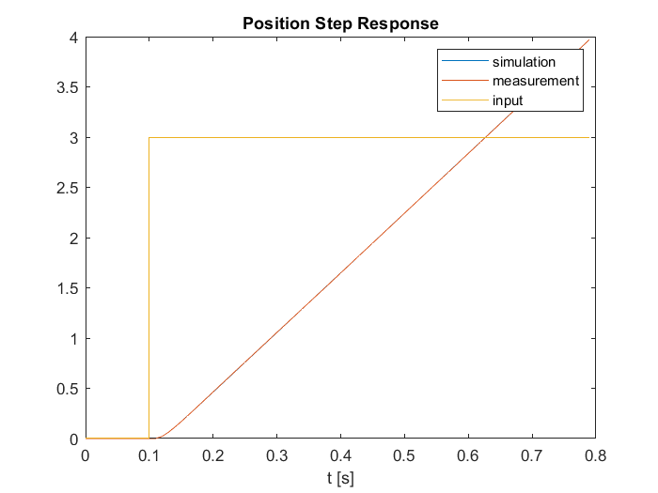
Results: validation

Slide 6
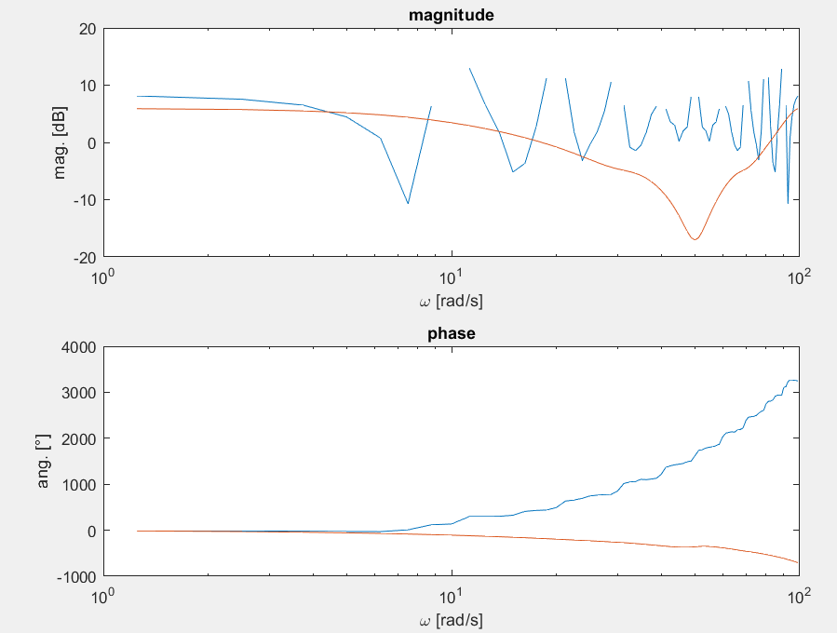
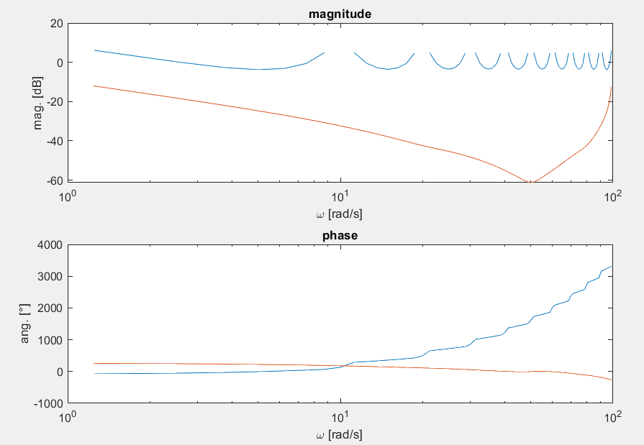
Results: validation
Speed model
Posit model

Slide 7
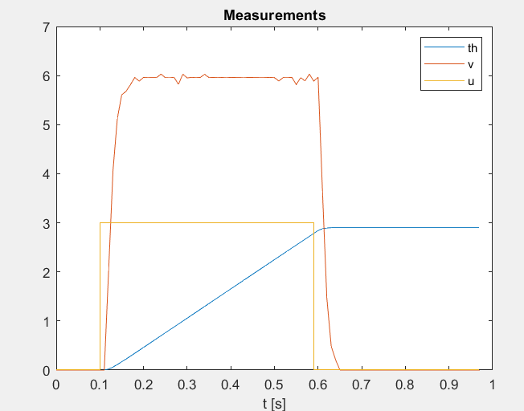
Excitation

Slide 8
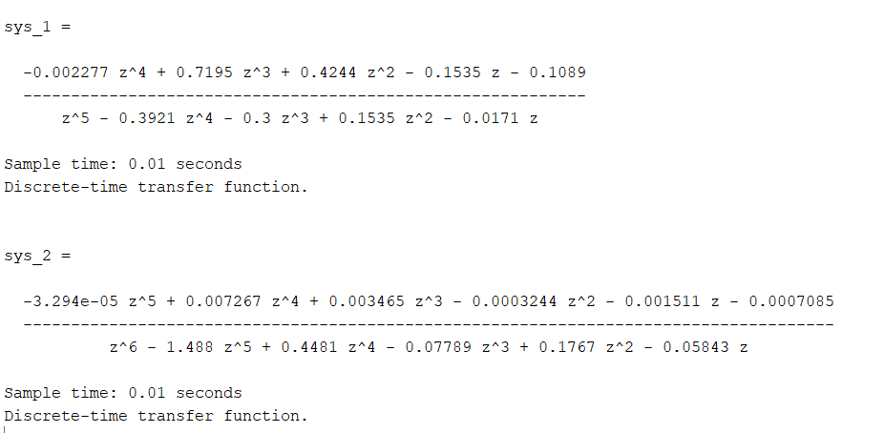
Result

Slide 9
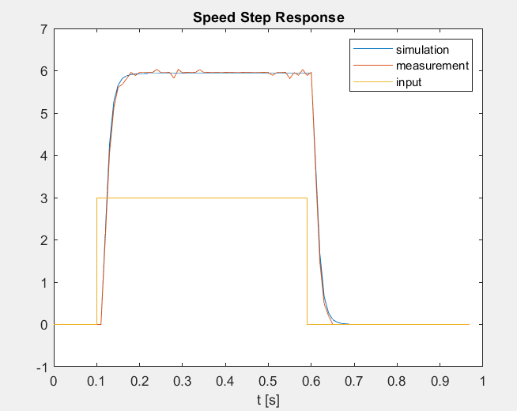
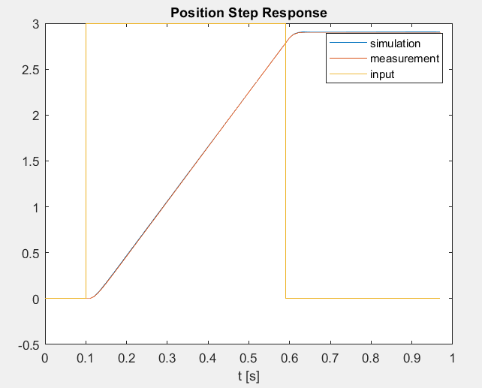
Result: validation

Slide 10
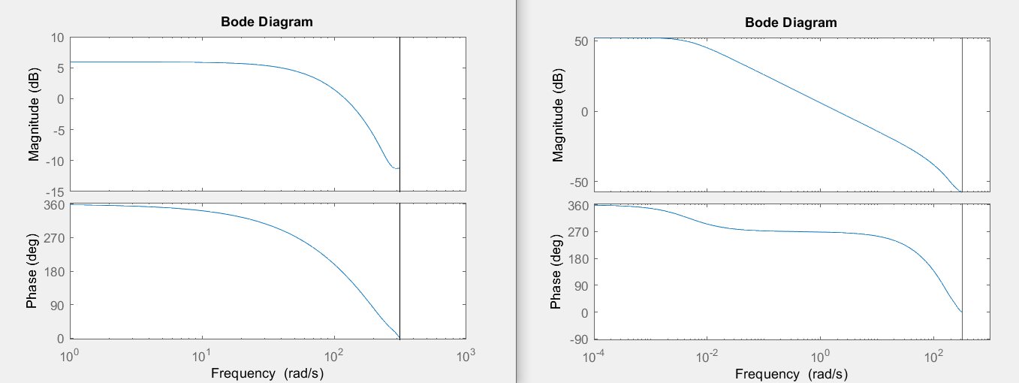
Result: validation
Speed model
Posit model

